Slide 1

ILI Group
Flemyland Energy Storage Project
Presentation & Q&A
Greig Templeton - Planning Manager
gt@ili-energy.com
Andrew Hughes – PR & Media Manager
ah@ili-energy.com
07456 539239
Presentation Times
3.10pm, 3.45pm, 4.15pm, 4.45pm
5.15pm, 5.45pm, 6.15pm, 6.45pm

Slide 2
What is the project?
100MW Energy Storage facility containerised Battery Storage
The development would consist of containers containing batteries and associated equipment, an access track, electricity, meter building and fencing
Stores excess energy from the grid
Puts electricity back into the grid when required
This helps balance the supply and demand for the grid

Slide 3
Who are ILI Group?
Energy Storage Development Company
Based in Hamilton, Lanarkshire
Started in 2017
Bringing 4.5GW of Energy Storage to Scotland
Developing 3 Pumped Storage Hydro Projects 450MW +
2GW of Battery Storage

Slide 4
Why is it needed?
Scotland has a Target of Net Zero by 2045
Renewable energy is intermittent, This means we can’t rely on it to meet demand
Fossil fuel generators coal gas and nuclear make up the difference
As these go offline we need to be able to meet that demand
Energy storage lets us store renewable energy for when it is needed
OFGEM have estimated we need up to 50GW of energy storage by 2050
The Scottish Energy Strategy, published 2018, supports new energy storage capacity. It states that the Scottish Government will continue to support innovation and deployment in storage and to work to accelerate its penetration across Scotland.

Slide 5
Why in this Location?
The land is located near the Kilwinning GSP
There is available capacity at the Grid Supply Point
Across Scotland there are very few Grid Locations that can accept this level of power.

Slide 6
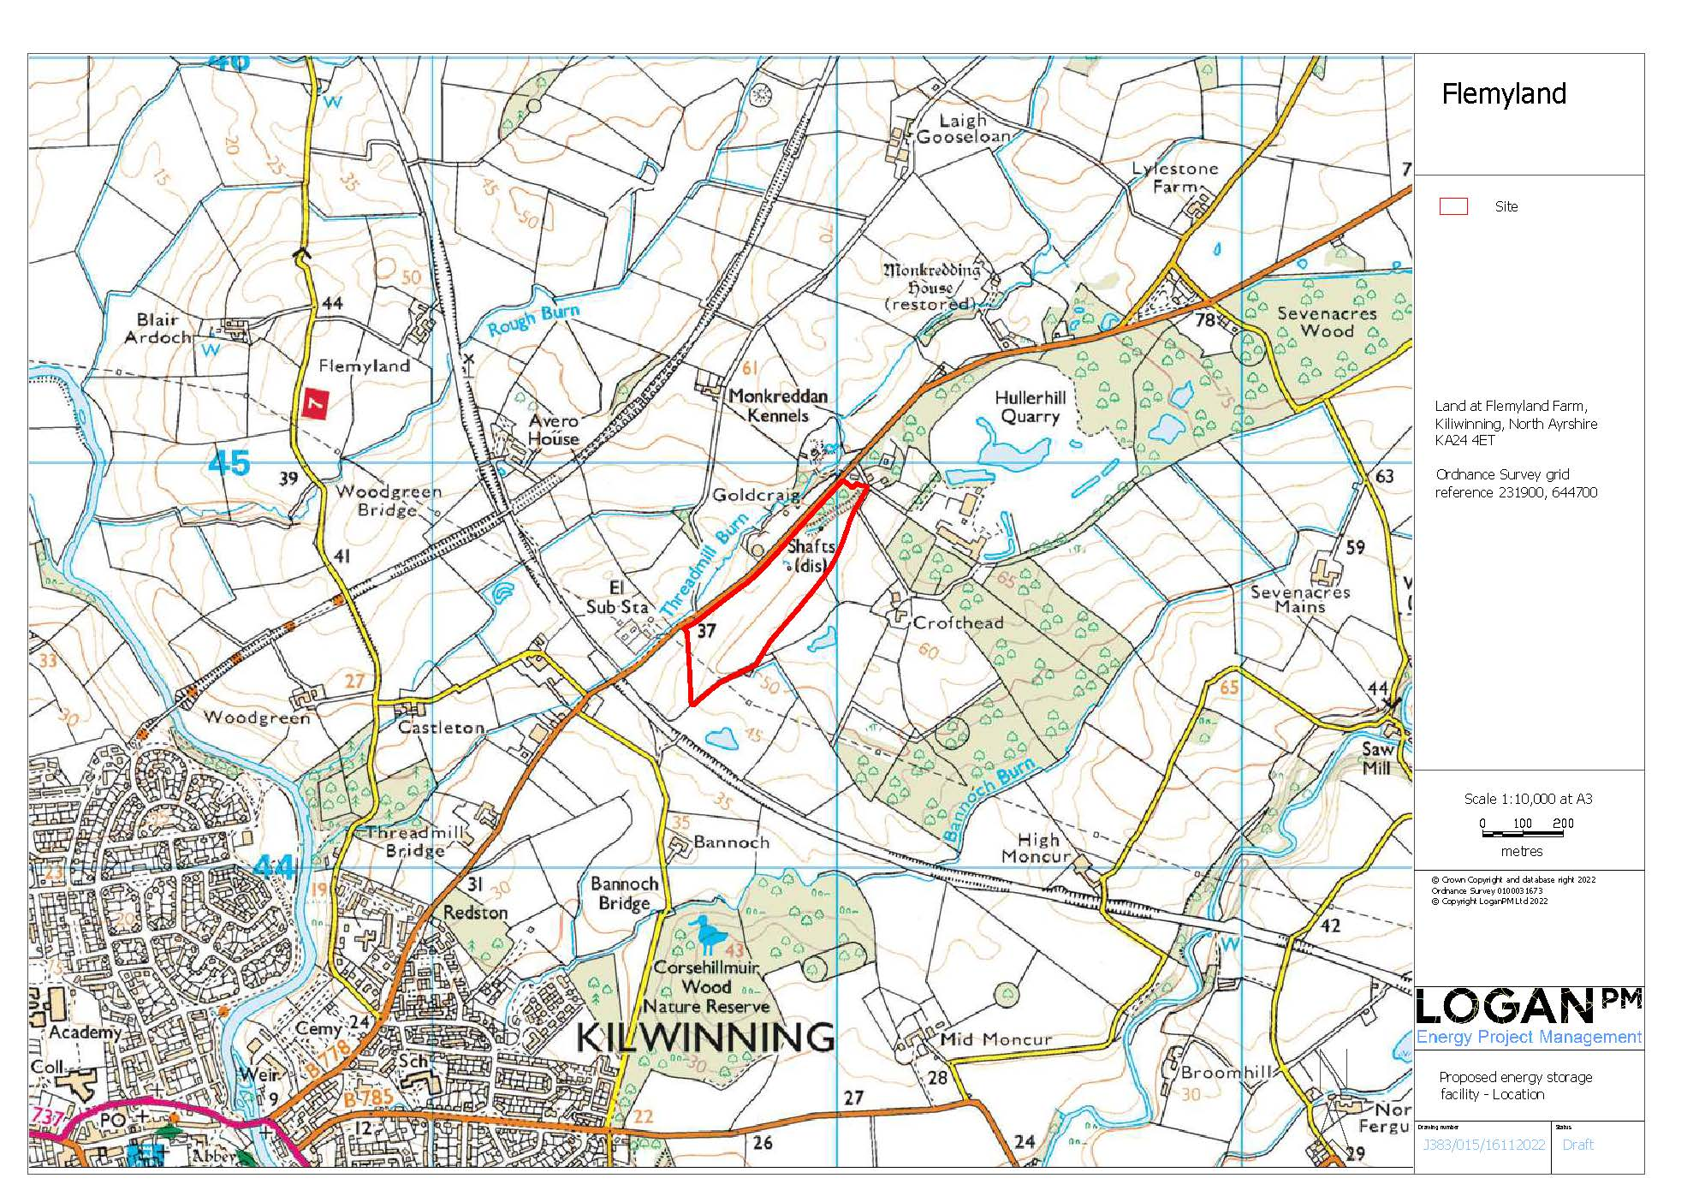
Location Plan
The site is located by the existing national grid substation on the B778 road around 1km north east of Kilwinning, by the Hullerhill Quarry.
It is proposed to set back the compound generally behind the existing trees.

Slide 7
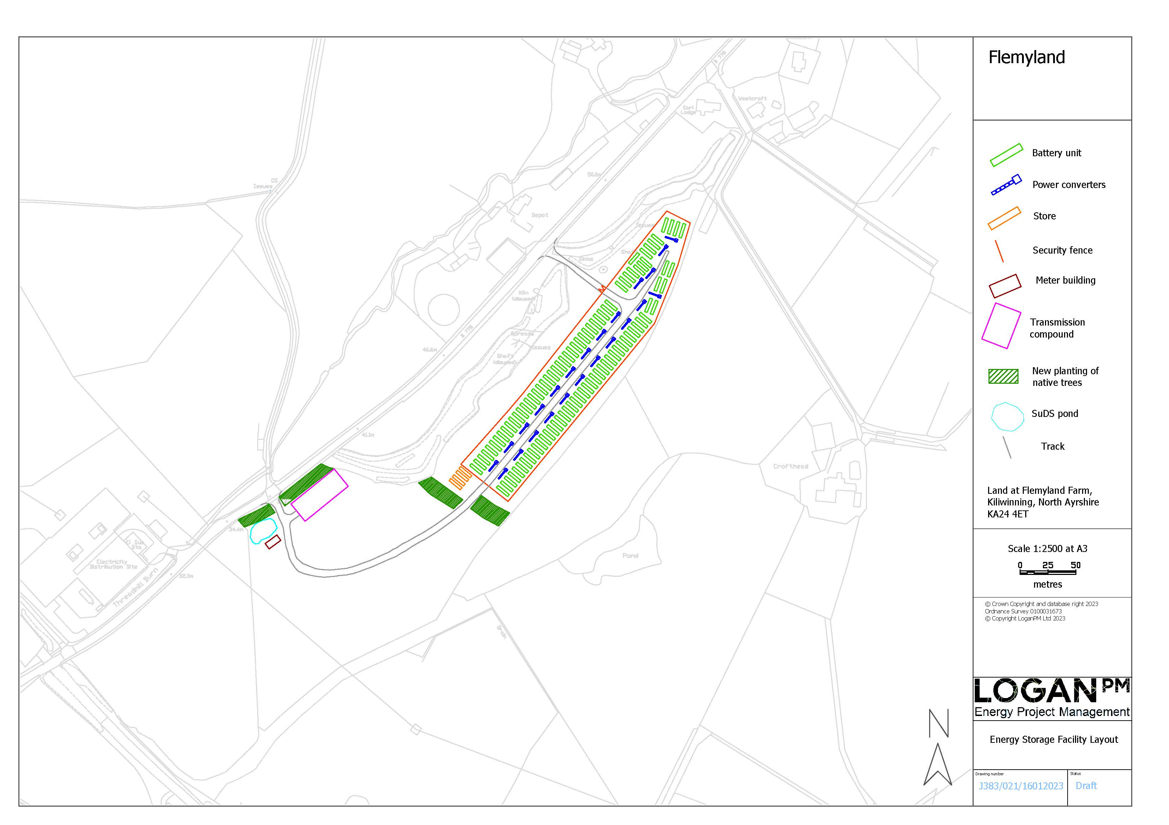
Site Layout
Energy Storage Units
Store Units
Retention pond
New Planting (native broadleaves (trees and shrubs)
3m Wooden Fencing
Track
Substation Enclosure
Stock fence

Slide 8
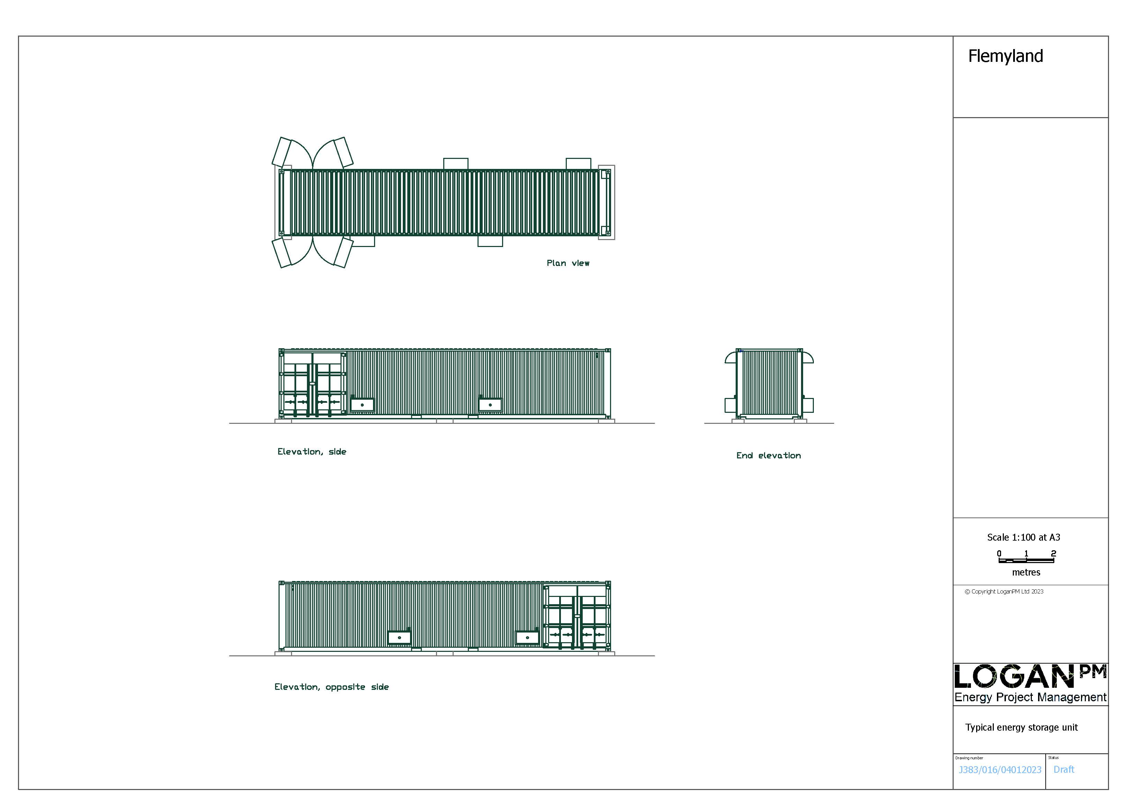
Energy Storage
Units
Batteries, inverters, transformers and control equipment will be housed in steel containers of 13 metres by 2.5 metres by 2.6 metres high.
Solid state lithium batteries. would be used, as successfully employed on many other sites in the UK and worldwide.

Slide 9
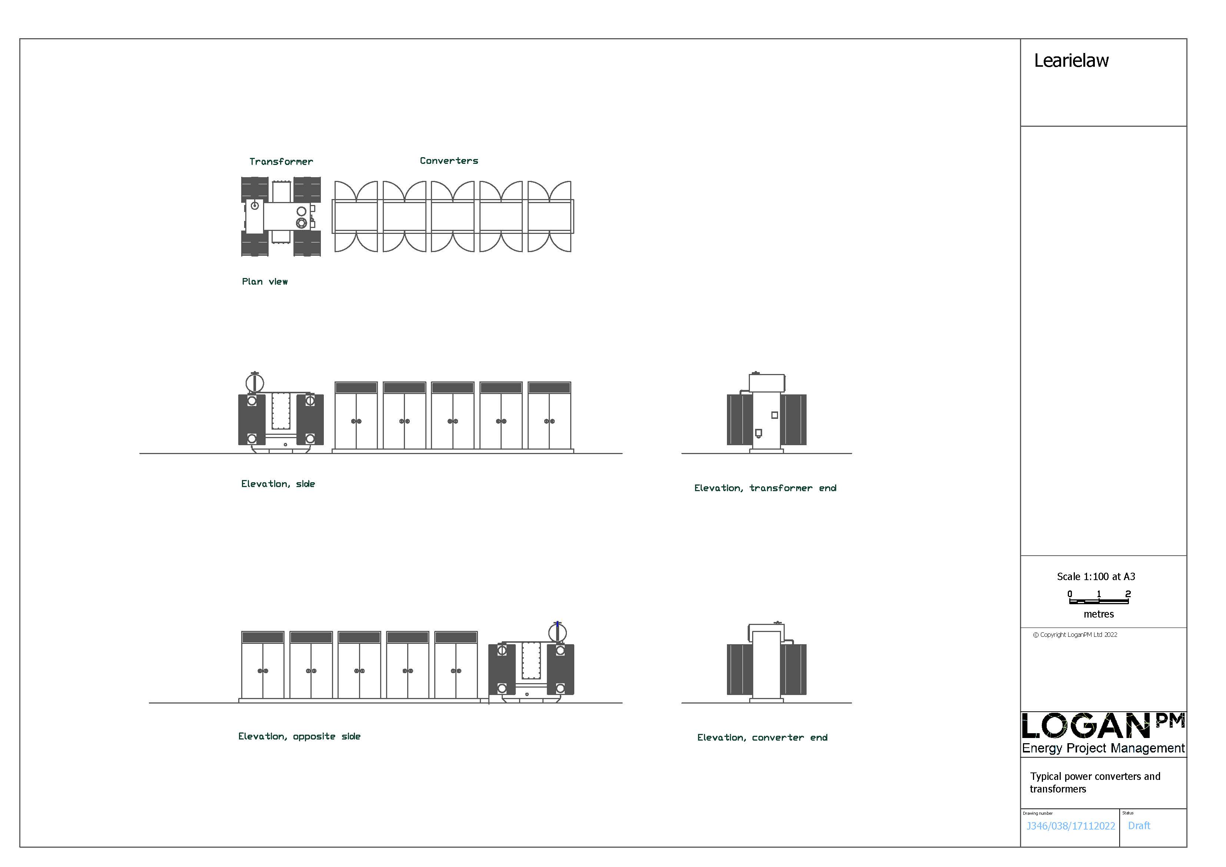








Converters & Transformers
transformers and converters are placed between the energy storage units
The power converters are around 1.6 by 1.4 metres, by 2.6 metres tall, and transformers are around 2.7 by 2.5 metres, by 2.8 metres tall.
The final equipment and size may vary slightly from that shown.

Slide 10
Substation
A small site substation is proposed to house Scottish Power switchgear, site switchgear, electricity metering and control equipment and health & safety equipment.
This would be a prefabricated GRP building up to 13 metres by 6 metres by 3.2 metres high. The colour would be agreed with the council.

Slide 11
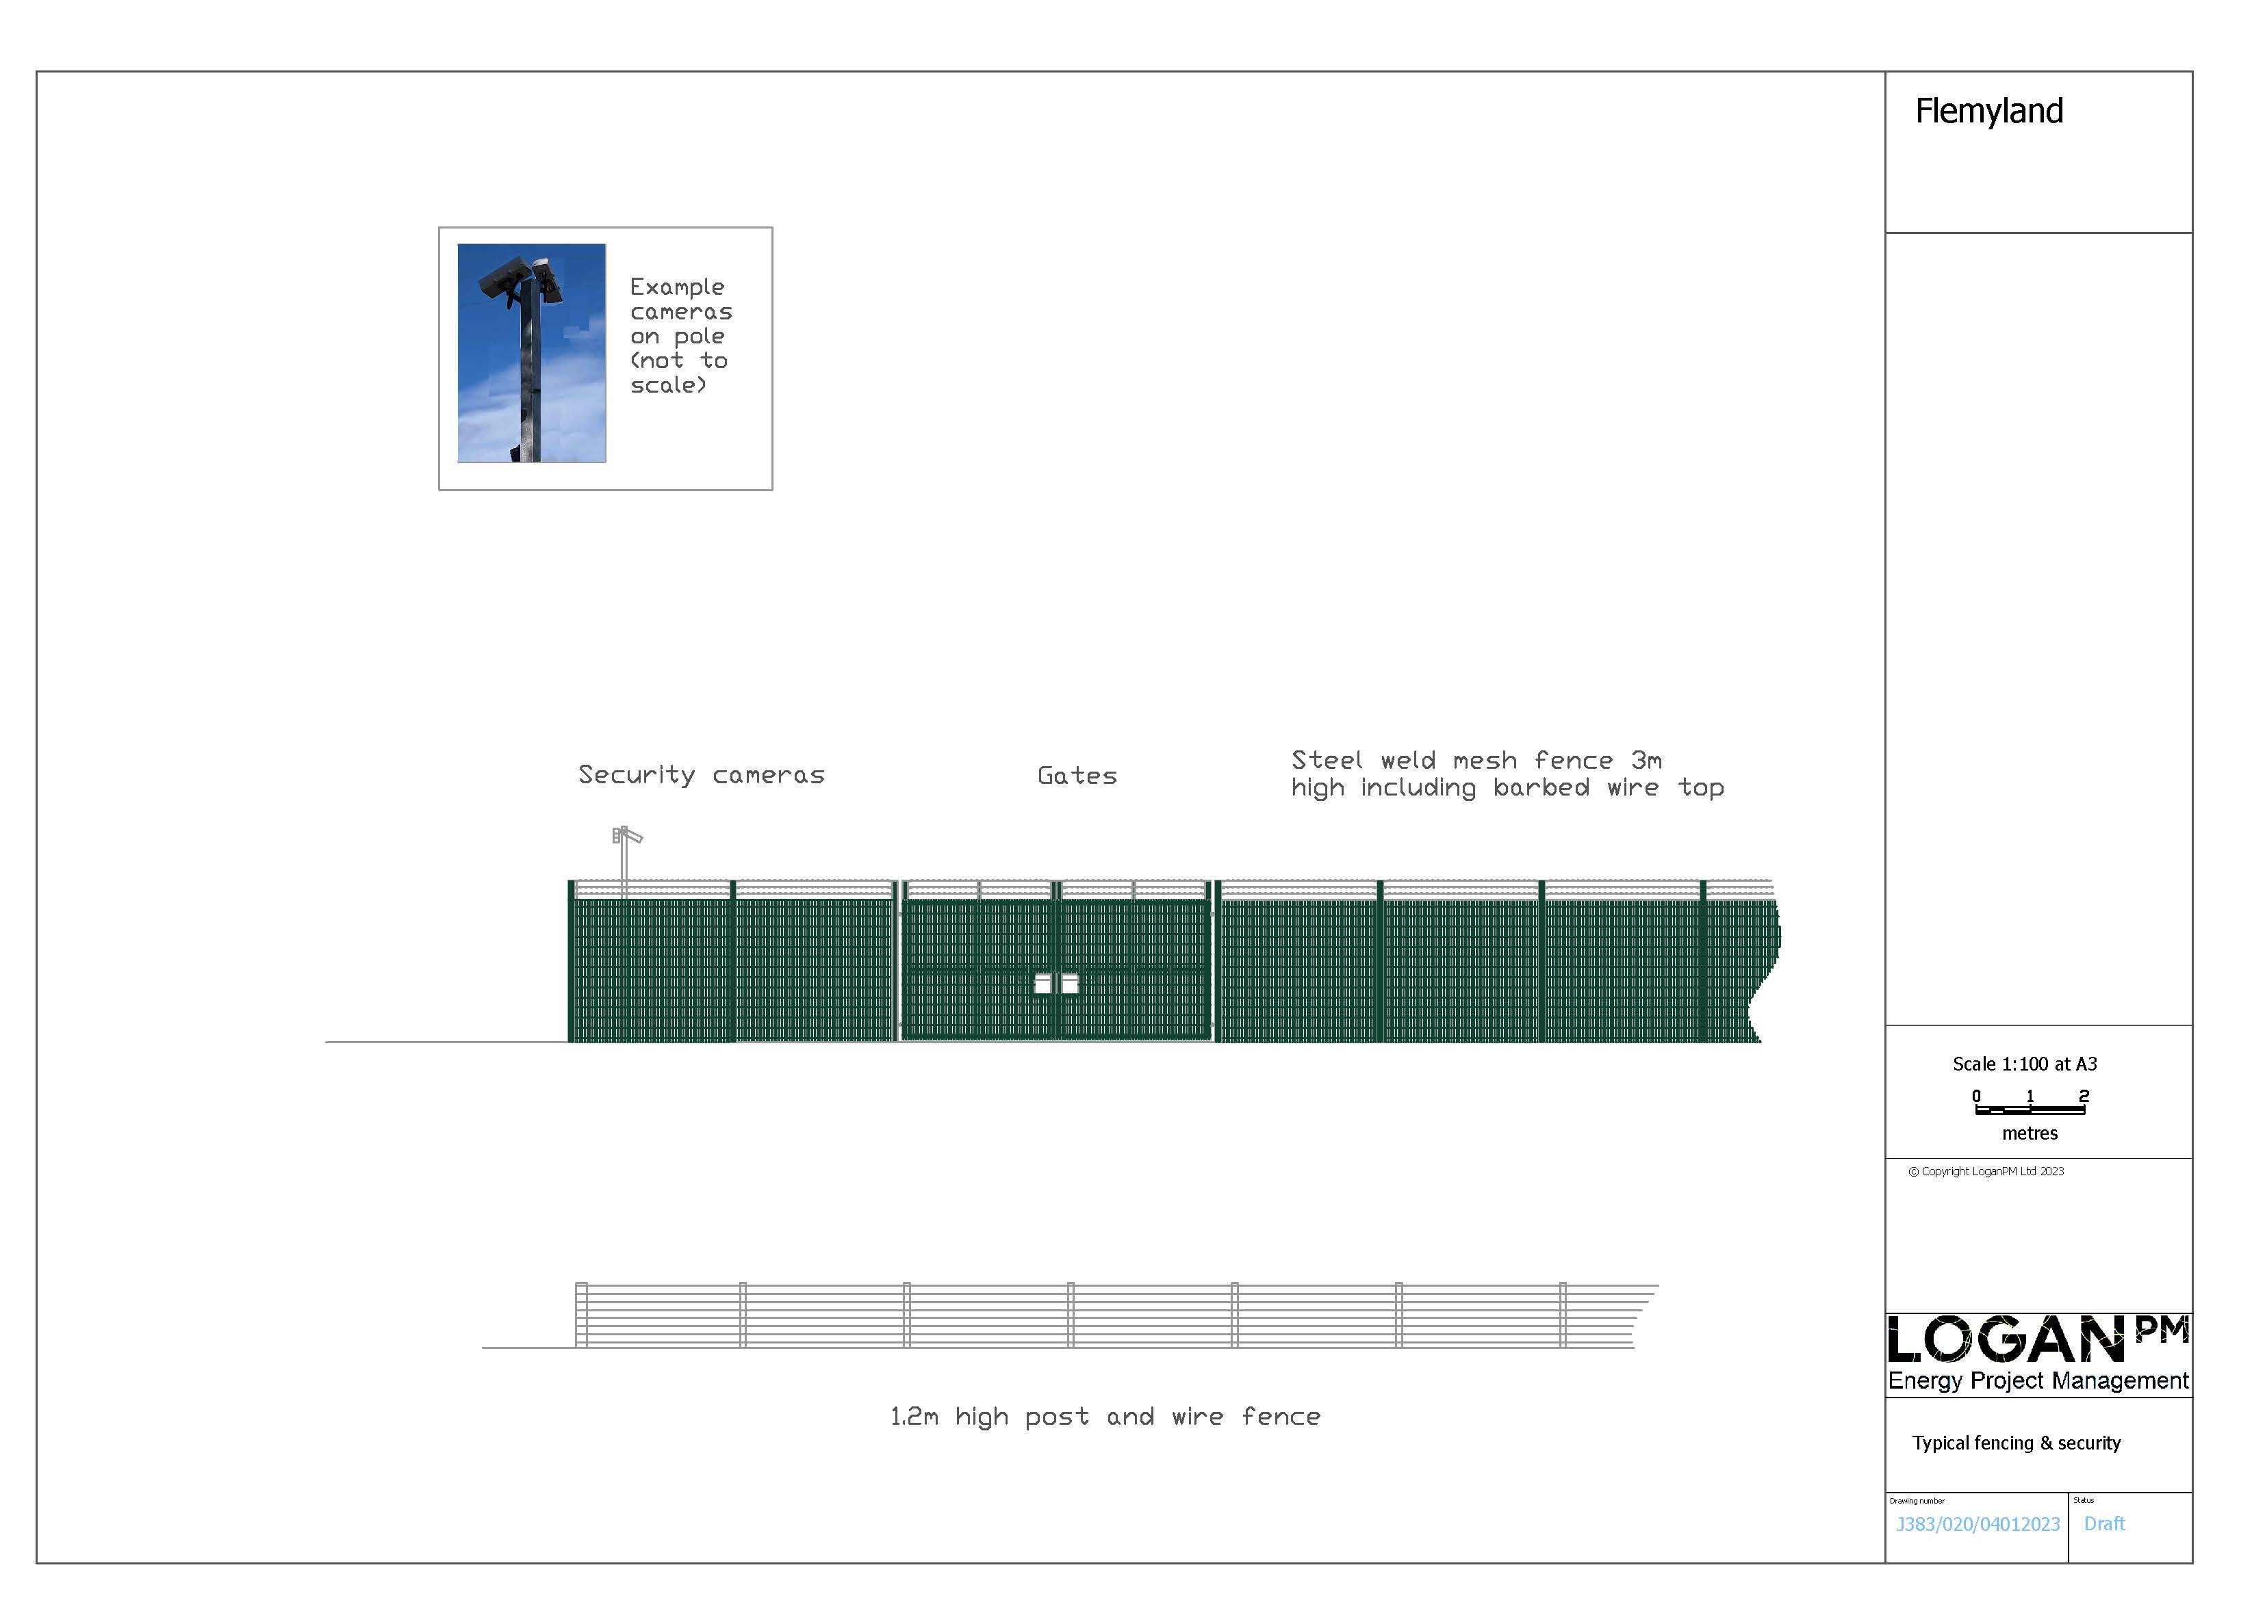
Fencing and Landscaping
3m high wooden fence of 12kg/m2 would be built around the battery site.
1.2m post and wire stock fence would be built outside of that#

Slide 12
Q&A
Any questions?

