Slide 1

Milligansbush Energy Storage Project
Presentation & Q&A
Andrew Hughes – PR & Media Manager
ah@ili-energy.com
Greig Templeton - Planning Project Manager
gt@ili-energy.com
Questions text to:
07456539239 or use online chat or email
Presentation Times -
3.10pm, 3.45pm, 4.15pm, 4.45pm, 5.15pm, 5.45pm,6.15pm, 6.45pm

Slide 2
What is the project?
200MW Energy Storage facility containerised Battery Storage
The development would consist of containers containing batteries and associated equipment, an access track, electricity, meter building and fencing
Stores excess energy from the grid
Puts electricity back into the grid when required
This helps balance the supply and demand for the grid

Slide 3
Who are ILI Group
Energy Storage Development Company
Based in Hamilton, Lanarkshire
Started in 2017
Bringing 4GW of Energy Storage to Scotland
Developing 3 Pumped Storage Hydro Projects 450MW +
1.5 GW of Battery Storage

Slide 4
Why is it needed?
Scotland has a Target of Net Zero by 2045
Renewable energy is intermittent, This means we can’t rely on it to meet demand
Fossil fuel generators coal gas and nuclear make up the difference
As these go offline, we need to be able to meet that demand
Energy storage lets us store renewable energy for when it is needed
National Grid ESO have estimated we need up to 40GW of energy storage by 2050
The Scottish Energy Strategy, published 2018, supports new energy storage capacity. It states that the Scottish Government will continue to support innovation and deployment in storage and to work to accelerate its penetration across Scotland.

Slide 5
Why in this Location?
The land is located near the Denny North GSP
There is available capacity at the Grid Supply Point
Across Scotland there are very few Grid Locations that can accept this level of power.

Slide 6
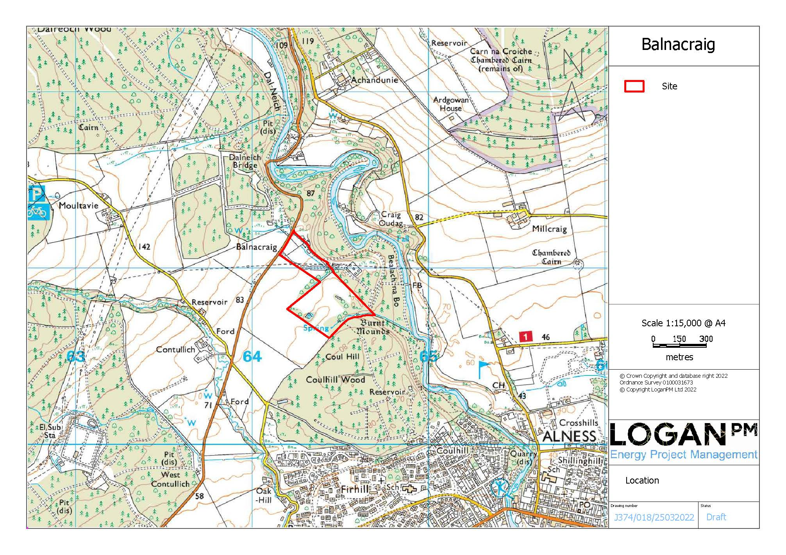
Location Plan
The site lies close to the Alness National Grid substation on grazing land, part of Mid Balnacraig, around 1km north of Alness.
The closest houses are at Mid Balnacraig around 300m to the north and upper Balnacraig at around 500m.

Slide 7
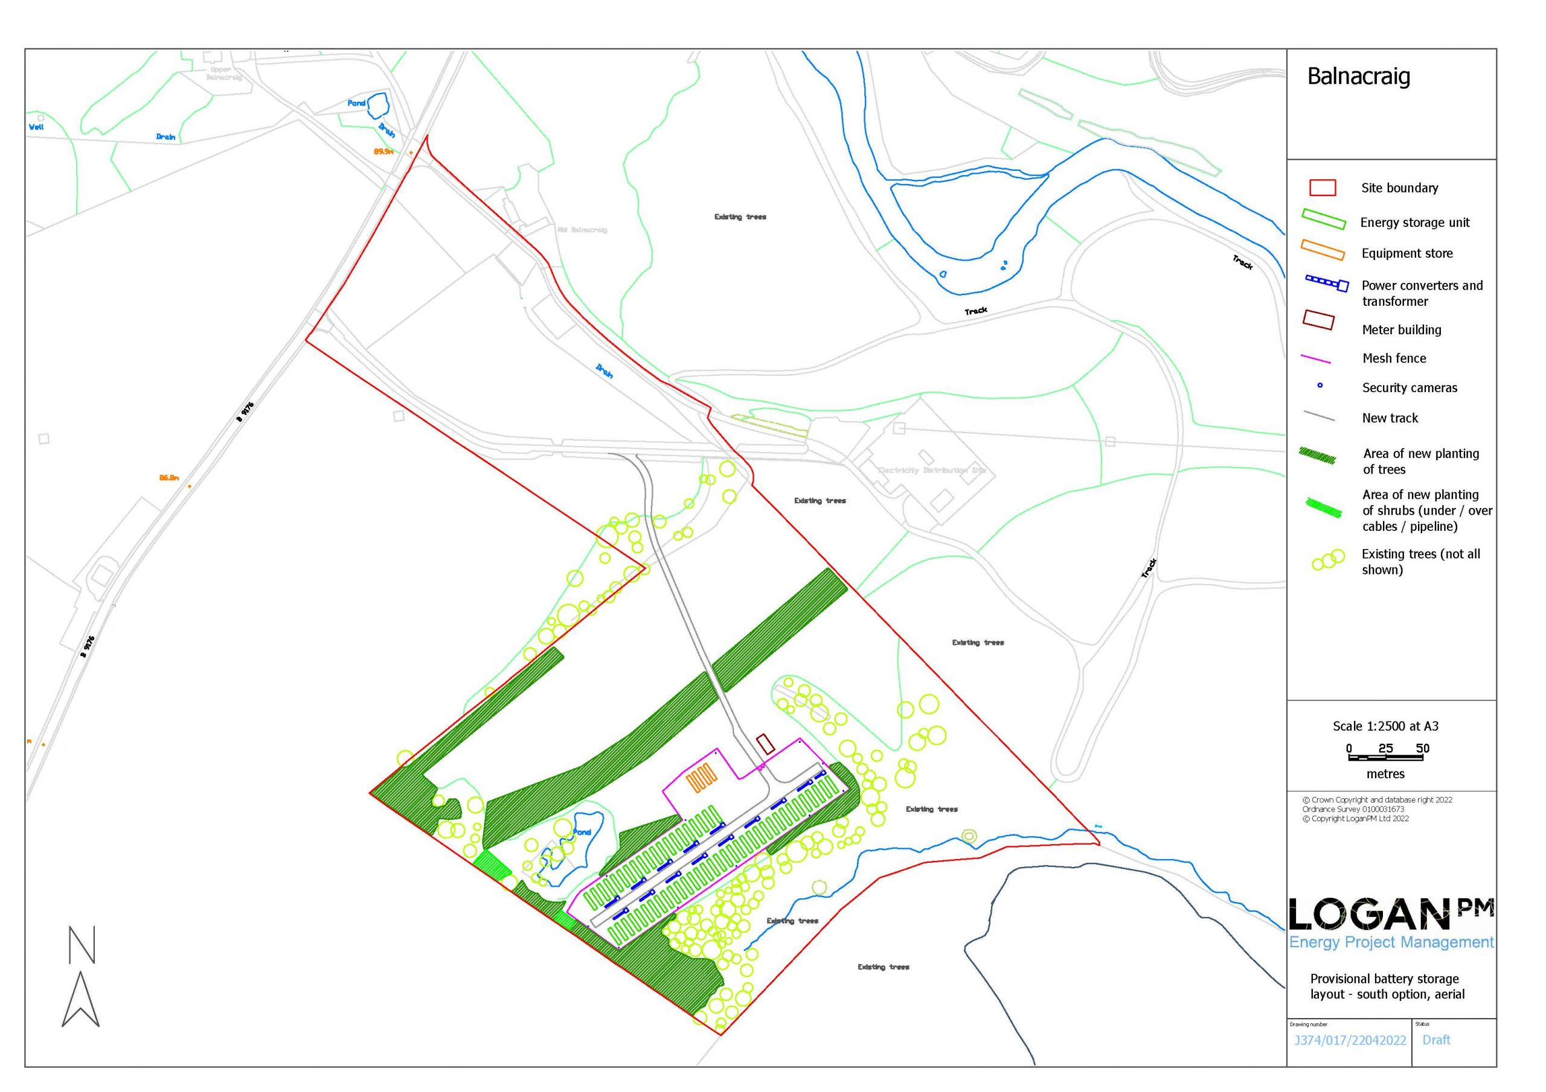
Site Layout Option 1
54 Energy Storage Units
2 Store Units
13 Converters and Transformer
New Planting (native broadleaves (trees and shrubs)
Track
Substation Enclosure
Final layout subject to change

Slide 8
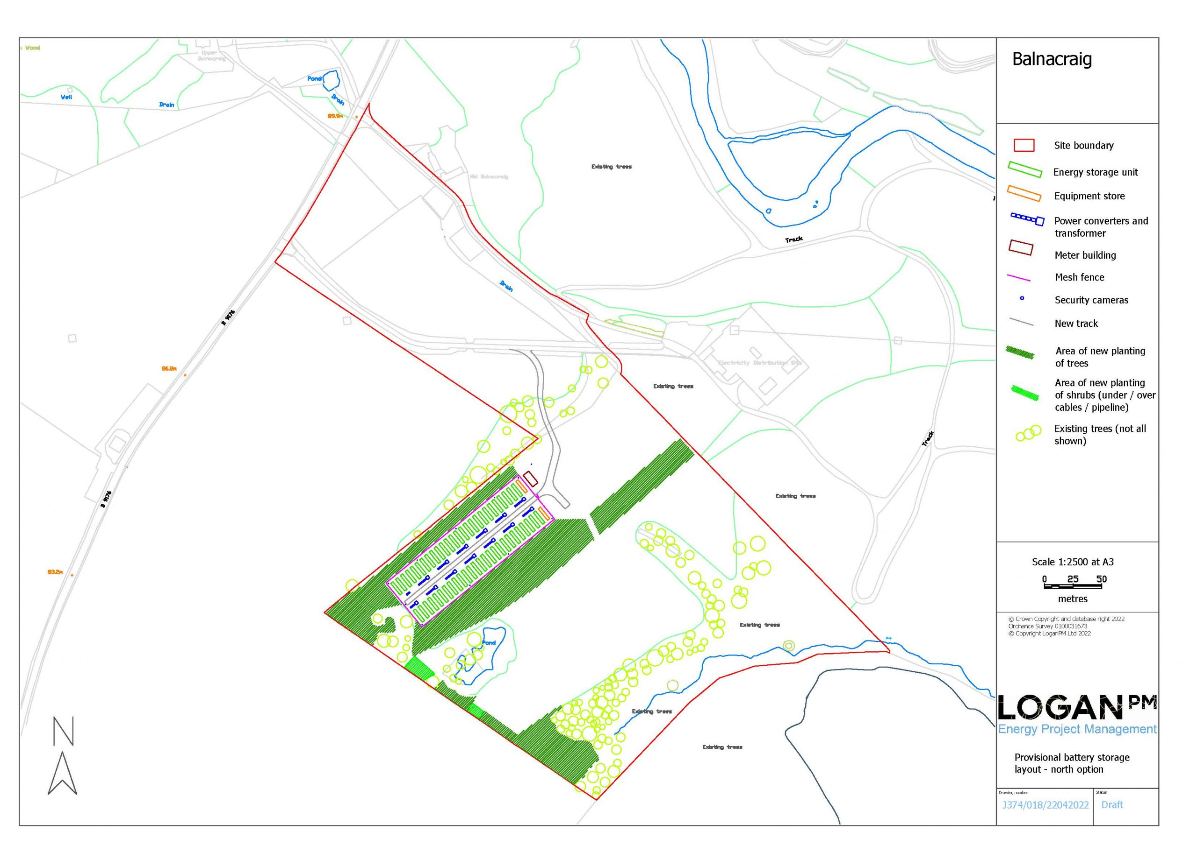
Site Layout Option 2
54 Energy Storage Units
2 Store Units
13 Converters and Transformer
New Planting (native broadleaves (trees and shrubs)
Track
Substation Enclosure
Final layout subject to change

Slide 9
Energy Storage
Units
Batteries and control equipment will be housed in steel containers of 13 metres by 2.5 metres by 2.6 metres high.
Solid state lithium batteries. would be used, as successfully employed on many other sites in the UK and worldwide.

Slide 10
Converters & Transformers
13 transformers and converters are placed between the energy storage units
The power converters are around 1.6 by 1.4 metres, by 2.6 metres tall, and transformers are around 2.7 by 2.5 metres, by 2.8 metres tall.
The final equipment and size may vary slightly from that shown.

Slide 11
Substation
A small site substation is proposed to house SP switchgear, site switchgear, electricity metering and control equipment and health & safety equipment.
This would be a prefabricated GRP building up to 10 metres by 6 metres by 3.2 metres high. The colour would be agreed with the council.

Slide 12
Q&A
Any questions?

